Slide 1

Settle down in Lyon, France
Segmentize districts using Python
Author: Esteban Avila – eaavila@gmail.com

Slide 2


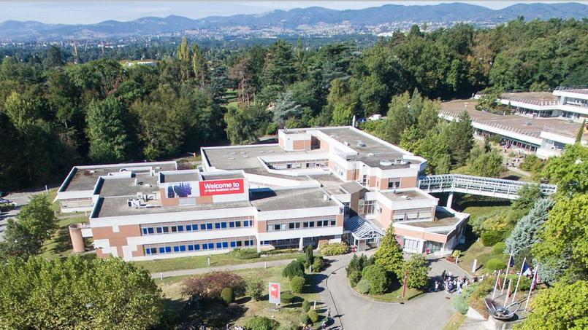

The problem
I will move myself into Lyon, in order to pursue an MBA. The program will be on a campus located at Ecully district, which is placed outside of Lyon center.
So, in order to be around campus and have a full French experience, I need to segmentize districts based on their distance to campus and their trending places around.

Slide 3
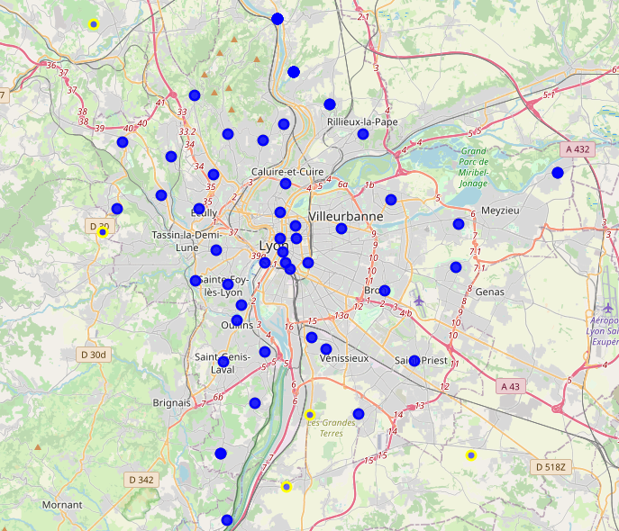
More about the problem
Lyon has 66 districts
Ecully is located at the west of the center of the city, which it is supposed to have greater number of trending places.
The mission is to segregate these districts using kmeans in order to get a short list of district to look at to rent a place, that makes compatible studying and enjoying in Lyon.
Once we have selected the cluster, we need to find out whose are the most convenient in terms of price for renting.

Slide 4

Methodology
1
Get the data from Wikipedia and then deploy it before using.
2
Use pgeocode to get the coordinates and distance to campus district for each district
3
Use foursquare query to rank each district with the number of venues.
4
Use kmeans to segmentize the district using distance and number of venues.
5
Map the results to analyze previous results and select a cluster to get more information
6
Find prices of the square meter to rent an apartment
7
Propose a district based in some metric.

Slide 5

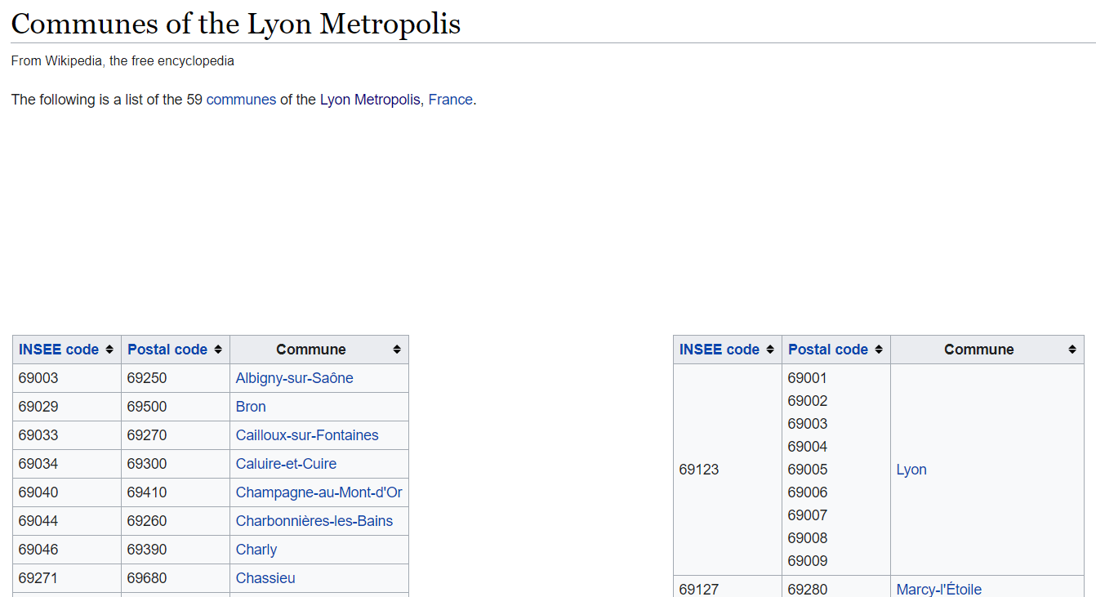
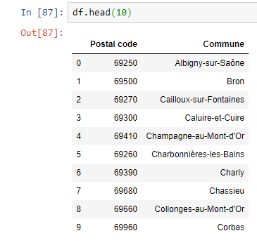
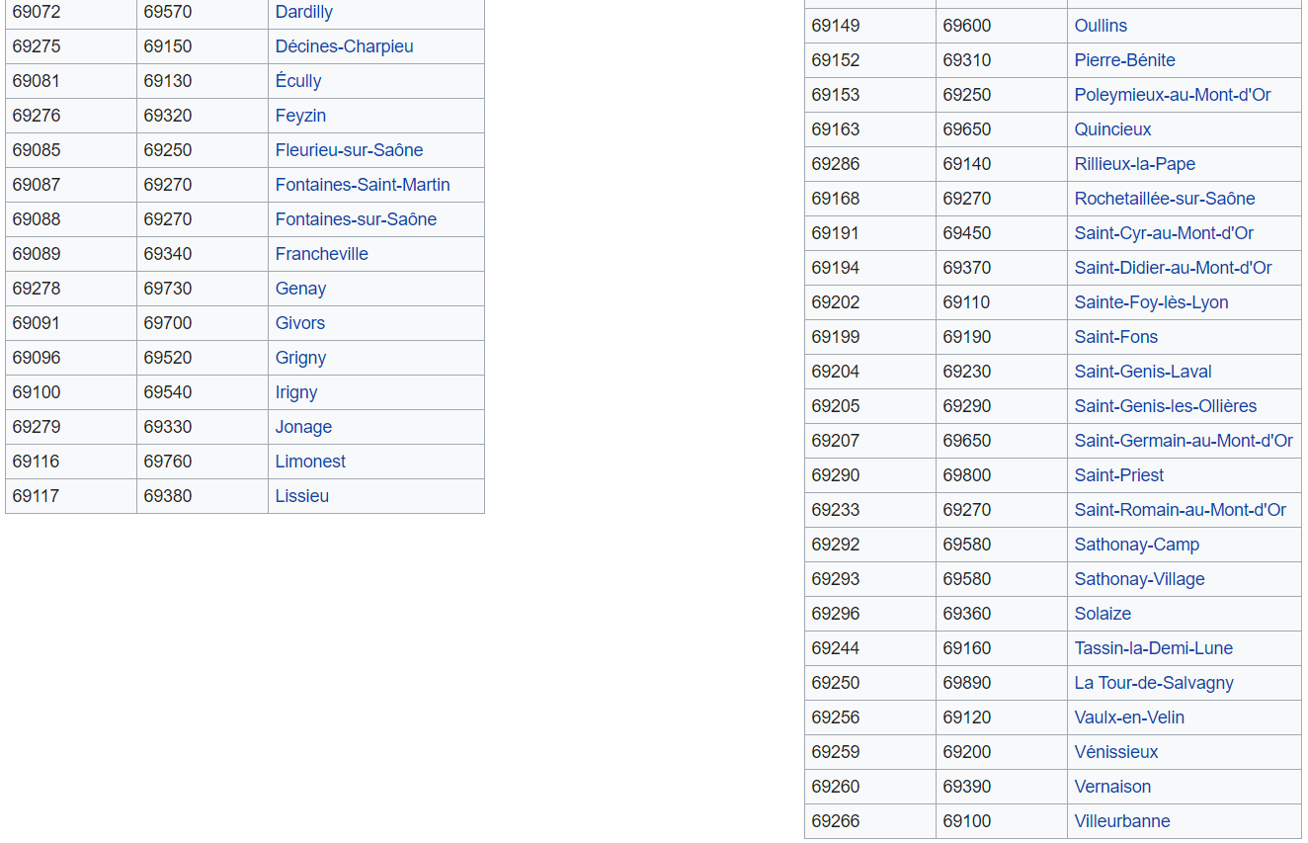
Data acquisition and cleaning
https://en.wikipedia.org/wiki/Communes_of_the_Lyon_Metropolis
Data deployment

Slide 6
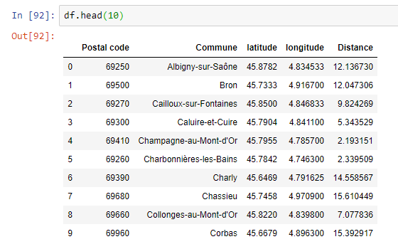
Getting coordinates and distance using geocode
Old DataFrame
New DataFrame
Variable for segmentizing

Slide 7
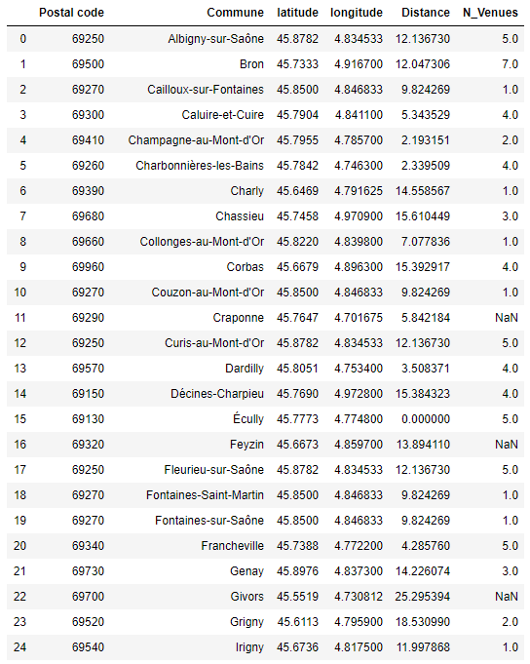
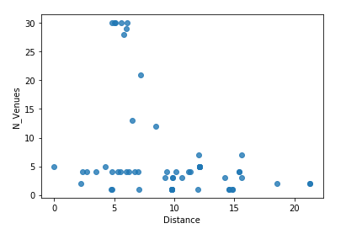
Use Foursquare to get the number of Venues of each district
Exploring at the data, it will be prioritized the districts which have at least 3 venues and a distance lesser than 20 kilometers.

Slide 8
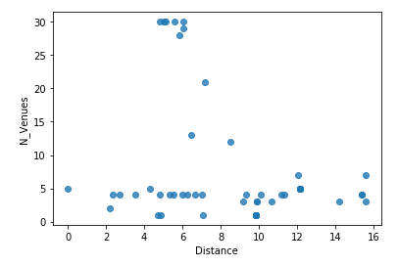
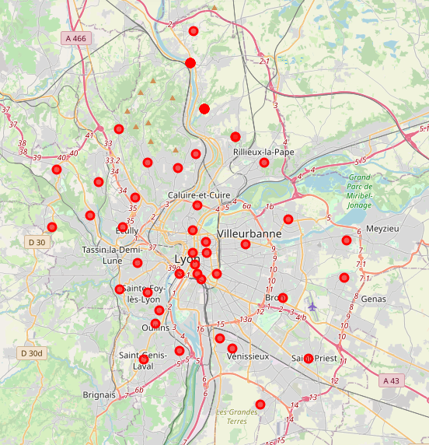
Selecting and Exploring the data
42 districts will be segmentized instead of the total of 66.

Slide 9
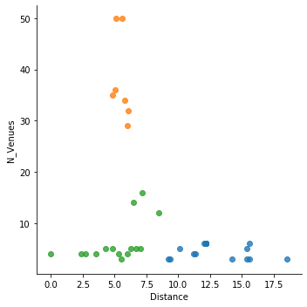
Use kmeans to retrieve a segmentation
Cluster N1
Districts with high amount of venues and with distance to campus between 4 to 8 kms.
Cluster N2
Districts with low amount of venues and with distance to campus between 0 to 8 kms.
Cluster N3
Districts with low amount of venues and with distance to campus more than 8 kms.

Slide 10
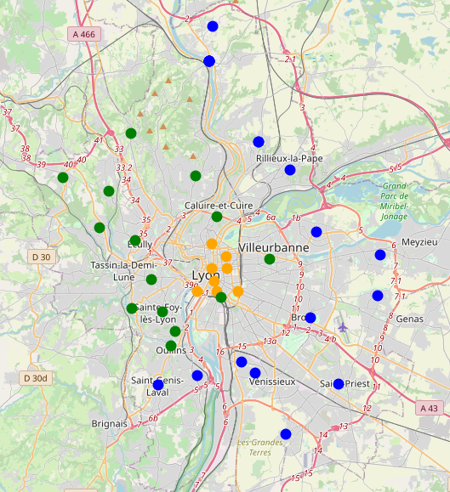
Visualizing the first results
It is clear that Cluster 3 should be avoided because it is far from campus and does not have much things to do. It confirms a prejudice that outside city things get boring for tourism.
Cluster 2 congregate not very far districts from campus and with similar things to do.
Cluster N3
Cluster N2
Campus
Cluster N1
Even if Cluster 1 is not near the campus, the distance to campus is closer than cluster 3, and there are more things to do here. This confirms than living in city center is a good choice.

Slide 11
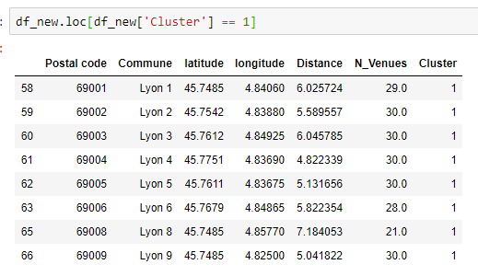
Visualizing the first results
It can be concluded that the bests districts to study at Ecully and to live the French experienced are located around Cluster 1.
The list of this districts is as follows:
Campus
Cluster N1

Slide 12
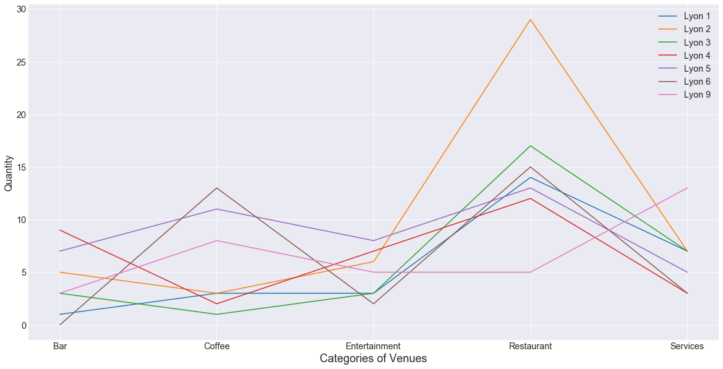
Visualization of qualities of the cluster’s districts
For instance, Lyon 2 has the highest number of restaurants but not good at coffee and bars.
In order to rank these districts the price variable is needed.

Slide 13
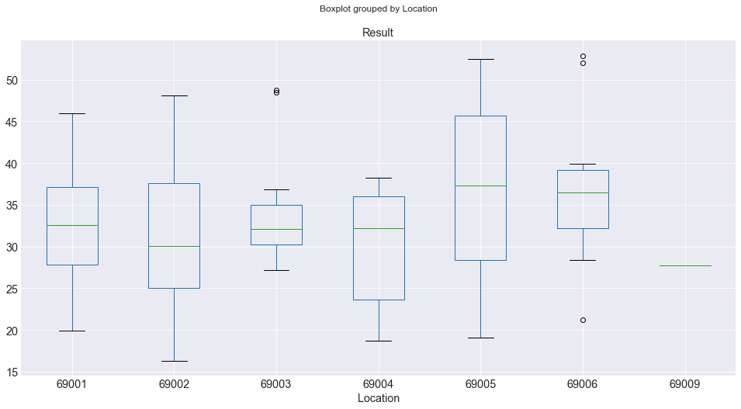
Price of each district of the cluster
To rank them, I selected to use the percentile-75 data, because I want to select a not cheap or mean apartment, but an expensive one to guarantee the quality of it.

Slide 14
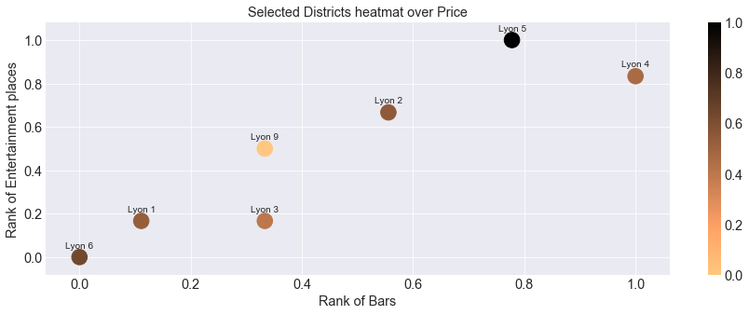
Results: Ranking the districts in the cluster
We need a metric, so I choose it based on my personal preferences, that is a combination of price (P75), number of bars and number of entertainment venues.
Seeing this graph, it is clear than Lyon 4 has most Bards and Entertainment places with a fair price. So, my insight from this job is to select Lyon 4 to be the best choice to live a Lyon.

Slide 15
Discussion
During this job I used several tools of python to accomplish this task, such as: data collect by scrapping webpages, data processing, segmentizing by Kmeans, Foursquare API, Matplotlib, among others. This was a good academic exercise in order to show what Python can do.
The results of this task, shows that living in the center of the Metropolis of Lyon is the best option regarding the distance and venues over the city, moreover it shows that there a huge difference at living center in terms of price of each district.
These results could be enhanced by adding extra features to describe each district. Probably, Foursquare data is biased by the fact that generally at the city center are more attractions than peripheric districts. So, adding other factors, such as: quality of life, cost of transport (instead of distance), density population among others, will improve this model.

Slide 16
Conclusion
Although the model can be refined, the results are still interesting, Lyon 4 offers more entertainment and bars for a better price than any other district of the center, all of these by a reasonable distance of the campus.
This will be useful when I will select my future district during next months.

